Slide 1





Financial Analysis of different States
By
Ananya Rakesh
Tools used-

Slide 2
IMPortant FinanciAl TerMs
Expenditures
Deficits & GDP
Taxes
Revenue Expenditure – That government expenditure does not lead to the creation of fixed assets called revenue Expenditure.
Capital Expenditure – The money spent by the government on the various development activities
Aggregate Expenditure – Expenditure made by the government in the economy
Social Sector Expenditure- the expending of the government on the welfare of the people
Revenue Deficit - it is the excess of its total revenue expenditure to its total revenue receipts.
Gross Fiscal Deficit – The Excess of total (Revenue & Capital) expenditure over total rev & cap)receipts excluding borrowing is called a fiscal deficit.
GDP(Gross Domestic Product)Goods and Services which are created inside the boundary of the State
Own Tax Revenue – it is the collection of taxes that are collected by states.

Slide 3
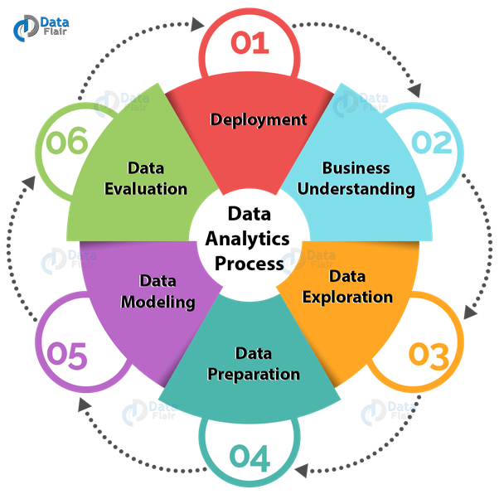
Problem STATEmENT AnAlyse the Financial Statistics of the States On the basis of a 5-year Interval and Find out some important information And KPIs From it

Slide 4
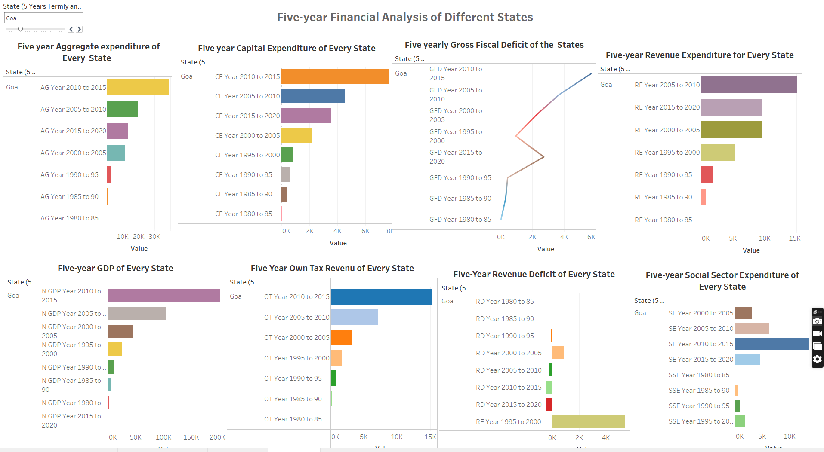
Financial Analysis of Different States in terms of Five Years
In this analysis we are comparing financials like Aggregate expenditure,
Capital expenditure, Gross Fiscal Deficits, Nominal GSDP, Own tax revenue, Social sector expenditure, Revenue Deficits, Revenue expenditure on the basis of five years.

Slide 5
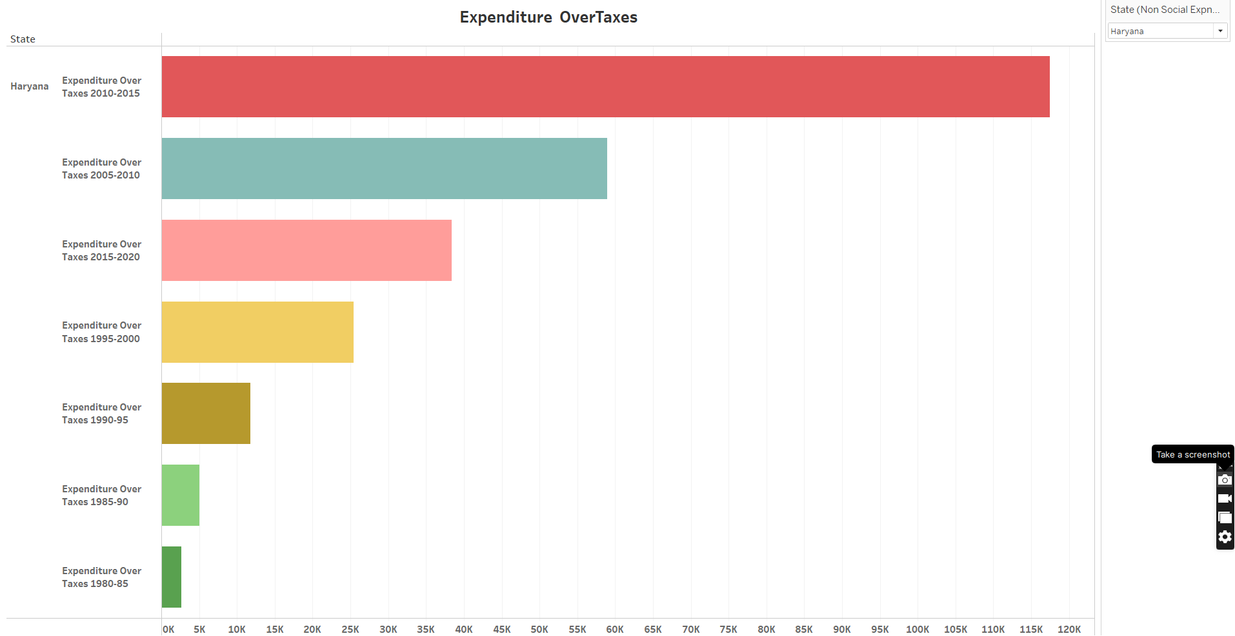
Aggregate Expenditure vs Own tax revenue
From this data, we found that taxes which come from various source are not sufficient for the expenditure of the government and the government need more sources of income to expense for ex ipos and Foreign Investments.

Slide 6
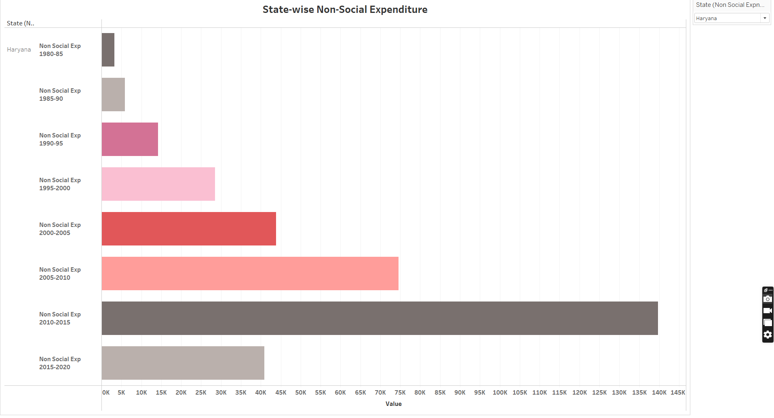
2nd insight-[Aggregate Expenditure-Social sector Expenditure]
This data will help to understand what part of the Total or Aggregate Expenditure the Government Expending on the well fare of the State.

Slide 7
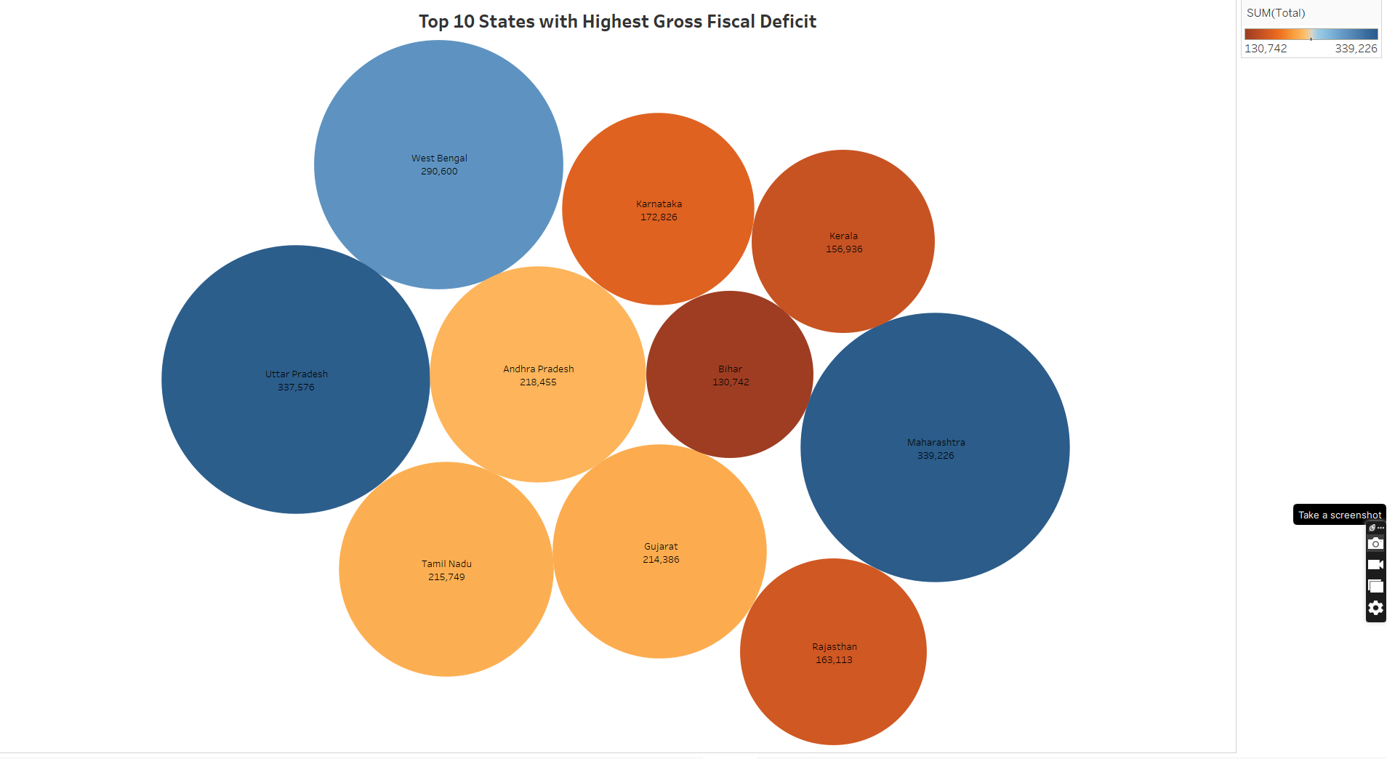
TOP 10 STATES WITH HIGHEST GROSS Fiscal DEFICITS
From this insight we found top 10 states whose expenditure is more than income they expect . It is an indication of the total borrowing needed by the
Government. These states Maharashtra, Uttar Pradesh , West Bengal, Andhra Pradesh Tamil Nadu

Slide 8
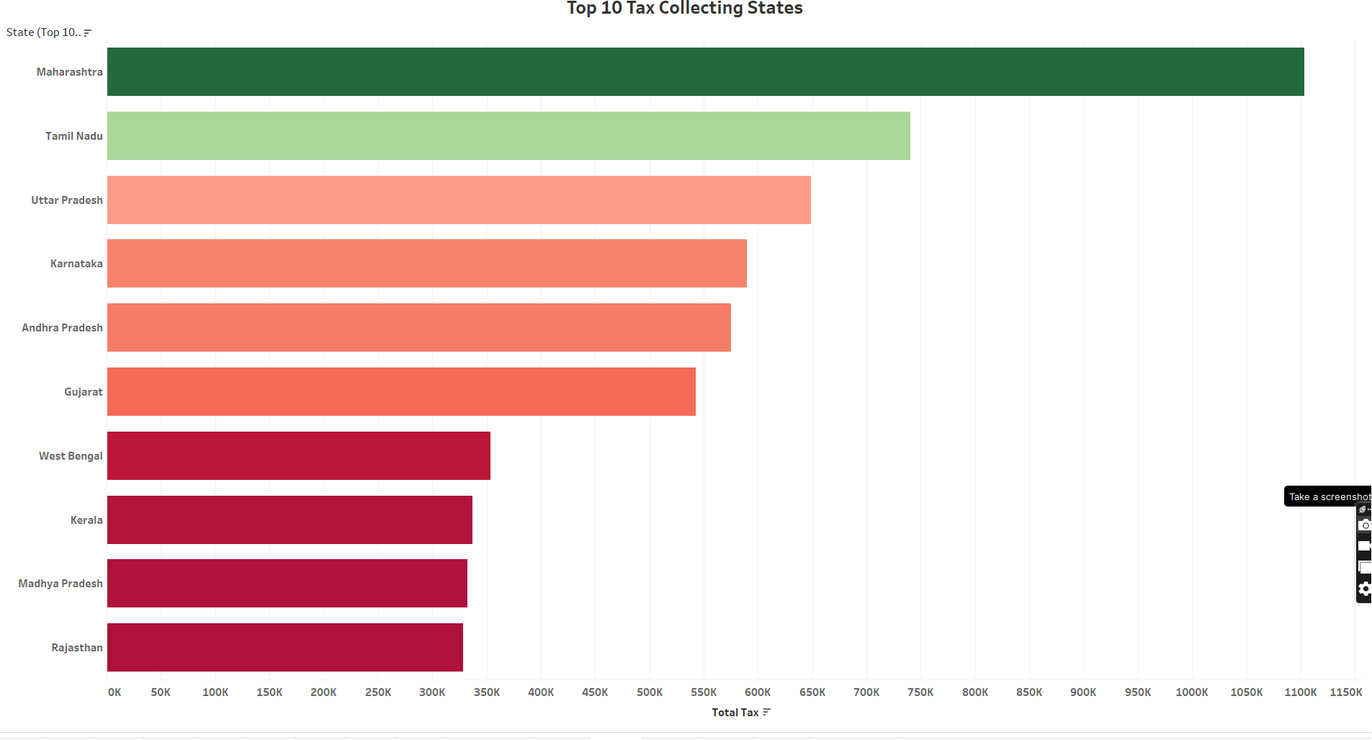
Top 10 tax collecting States
This insight is very helpful to know the various facts that the how much percentage of the population of the people have jobs and what are their purchasing power. Madhya Pradesh , Tamil Nadu, Uttar Pradesh Karnatak Andhra Pradesh ETC.

Slide 9
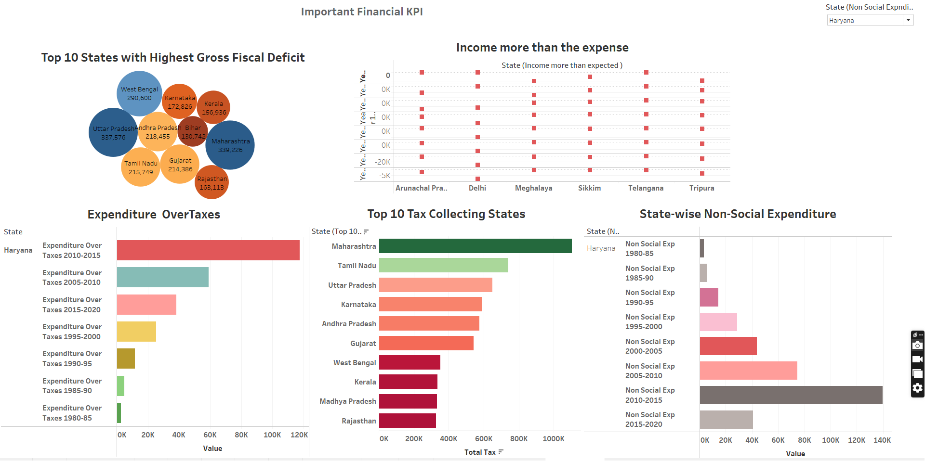

Slide 10
Conclusion Our final understanding is that these observations these statistics are important for the government to prepare various plans for the welfare of the people. And also it is important For the Investors To know whether the Government is in loss or Profit if the government is in loss it doesn’t give any subsidies to the investors

Slide 11
Thank you Everyone

